Slide 1
The KNIME Demo Library: Credit Scoring
Alexander Fillbrunn
October 2021

Slide 2
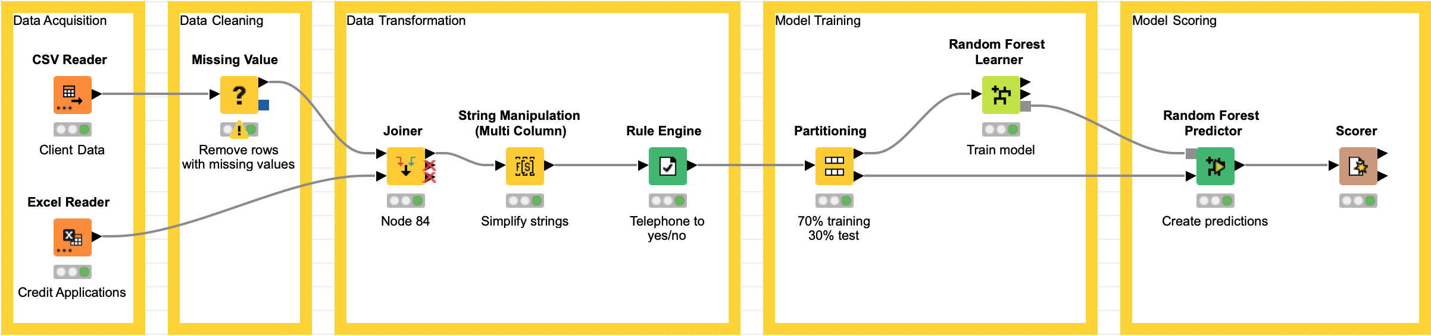
Summary
This set of workflows is meant to show an end-to-end machine learning use case with data loading and cleaning, model building, deployment, and final usage as REST API or WebPortal application.

Slide 3
Overview
Focus
ML Pipeline (End to End)
Data Joining & Cleaning
Reporting
Integrated Deployment
REST API
Other shown Features
CSV/Excel Import
Random Forest
Data
Credit Data from Hub: https://kni.me/w/CB0u_eLmzlghiZI2
Size
3 workflows
Time
~30-45 minutes
Can be shortened by skipping either the smaller “Training” or the bigger “Train Model and Deploy” workflow

Slide 4
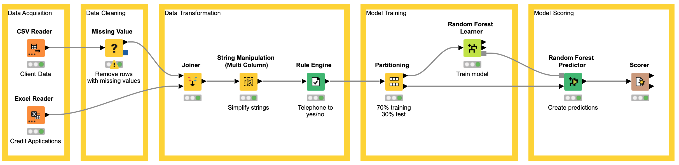
Credit Scoring
Determines the creditworthiness of a person or business
Can be automated based on historic decisions → Machine Learning
Outcome: Approve/Deny → Binary Classification Problem
Tasks:
Data Acquisition
Data Cleaning
Data Transformation
Model Training
Model Scoring
Model Deployment
Model Monitoring
Model Updating

Slide 5
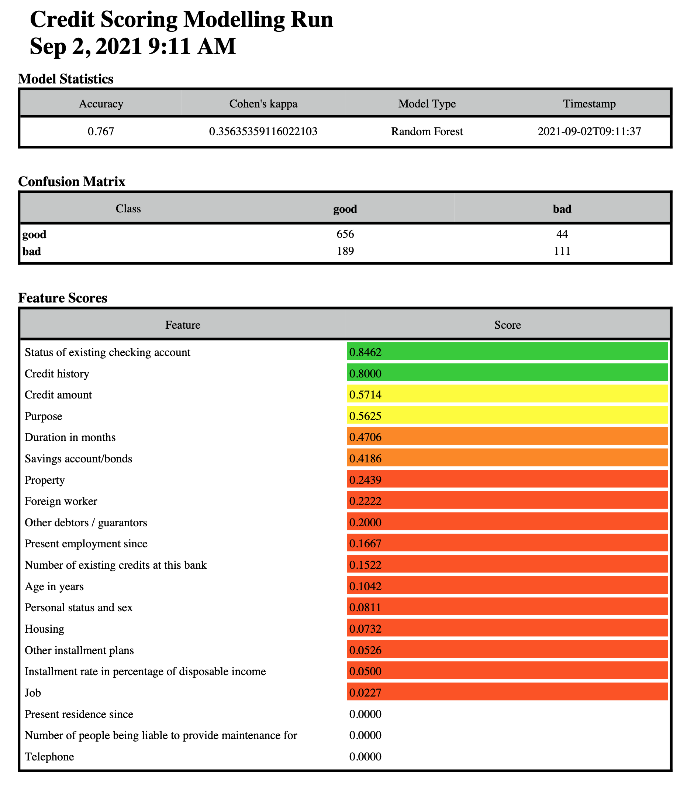
Main Artifacts
Model Training Report
Timestamp
Model Type (esp. when doing AutoML)
Accuracy, Cohen’s Kappa, Precision, Recall, F-Score, …
Confusion Matrix
Feature importance
…
Model
Format depends on where it should be deployed
Predictive Model Markup Language
ONNX
H2O MOJO
Workflow

Slide 6

Model Deployment
Workflows built with KNIME can be deployed in different fashions
Batch Execution
REST API
Data App

Slide 7
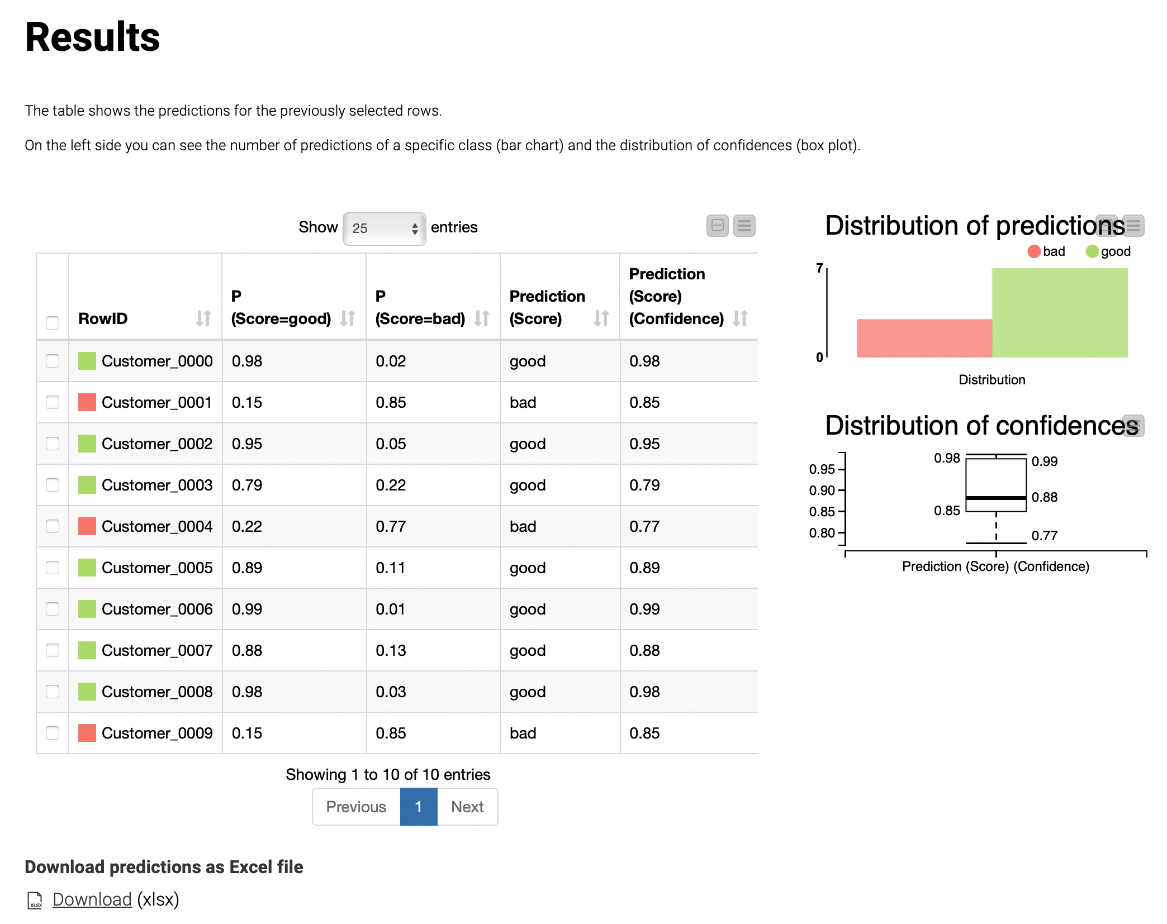
Workflows
Training
Loads data, cleans it, and trains a random forest model
Simple version of the “Train model and deploy” workflow
Train Model and Deploy
Loads data, cleans it, and trains a random forest model
Also calculates model accuracy using cross validation
Compares to existing model
Deploys model if it is better
Scoring DataApp
DataApp for batch scoring of new customers

Slide 8
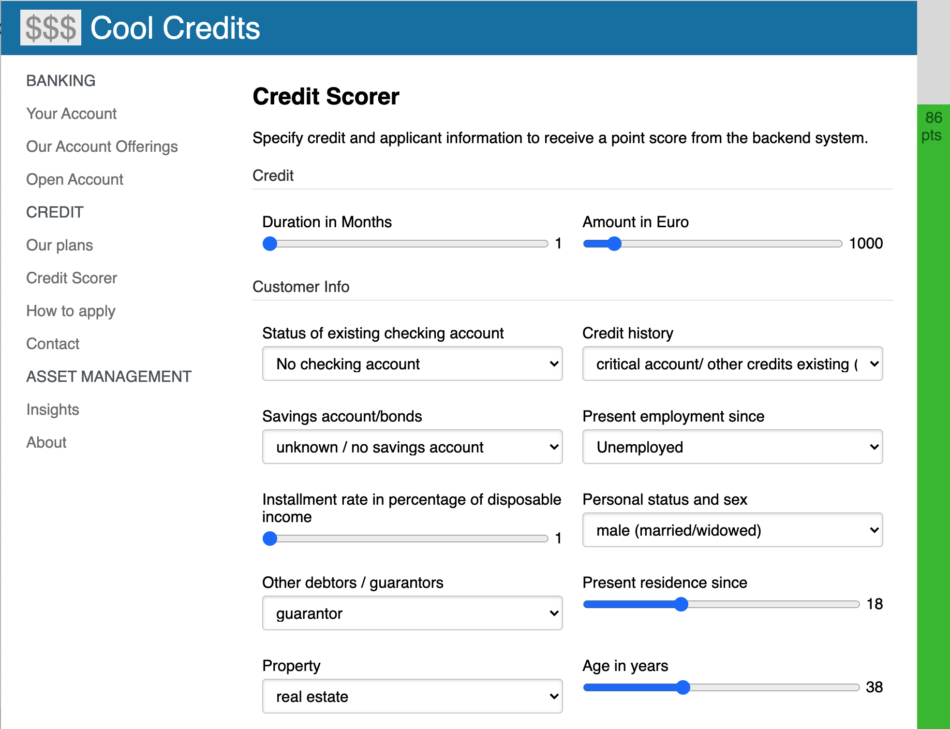
Special: Website making use of REST API
cool_credit.zip contains a website that calls the model via REST API
Credit worthiness shown live as points on the right
TODO for usage:
Turn off CORS in browser, e.g. by starting Chrome with --disable-web-security argument
Adjust path to CreditScoring workflow on server in index.js

Slide 9
The KNIME® trademark and logo and OPEN FOR INNOVATION® trademark are used by KNIME.com AG under license from KNIME GmbH, and are registered in the United States. KNIME® is also registered in Germany.

